Slide 1
Deep Learning-Based Object Detection: Advances, Techniques, and Applications
Submitted in the partial fulfillment for the award of the degree of
BACHELOR OF ENGINEERING
IN
Computer Science and Engineering with specialization in Artificial Intelligence and Machine Learning
Submitted by:
MAYANK CHOUHAN (22BAI70050)
ARSHDEEP YADAV (22BAI70007)
DEVANSHU ARORA (22BAI71425)
GOKULA KRISHNAN G V (22BAI70054)
Under the Supervision of:
JASWINDER SINGH (E15978)
Department of AIT-CSE
DISCOVER . LEARN . EMPOWER

Slide 2
Outline
Introduction to Project
Problem Formulation
Objectives of the work
Planning and Methodology used: Task Details
Results and Outputs
Conclusion
Future Scope
References

Slide 3



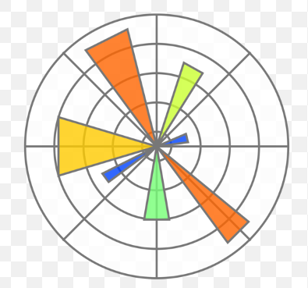
Introduction to Project
Project Objective:
Explore advanced deep learning techniques for object detection. Develop an efficient model and assess its performance. Apply the model to real-world research scenarios. The project seeks to deepen knowledge of object detection and its uses in other sectors where object detection can be implemented.
Tools Used :
Python
Tensorflow
Numpy
Matplotlib
Jupyter Notebook

Slide 4
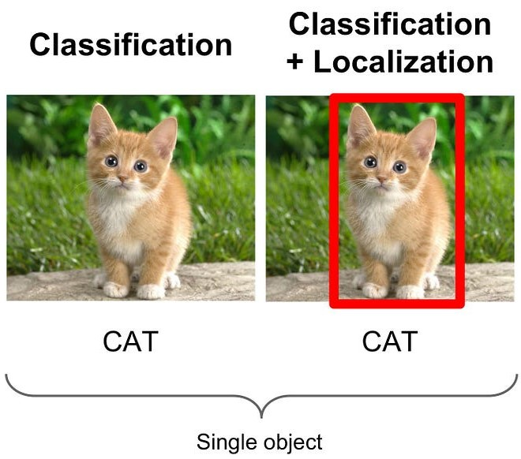
Introduction to Project
Deep learning-based object detection revolutionizes computer vision by identifying and locating objects in images or videos. By leveraging complex architectures and large datasets, these models achieve high accuracy in real-time, enabling applications such as autonomous vehicles, surveillance, and robotics. This research explores its applications across various sectors, advancements, techniques, and impact providing a comprehensive analysis of this transformative technology.

Slide 5
Problem Formulation
Traditional object detection methods faced challenges such as accuracy, scalability, and real-time processing.
Examples of limitations include difficulties in handling complex scenes, occlusions, and small objects.
The presentation addresses the need for advanced techniques to overcome these challenges.
Highlights the specific problems that deep learning-based approaches aim to solve in the context of object detection.
Illustrates the gap between traditional methods and the requirements of modern applications.
Emphasizes the significance of formulating the problem accurately for effective deep learning solutions.

Slide 6
Problem Formulation
Why it is required ?
Object detection is a crucial task in computer vision.
Traditional methods had limitations in accuracy, scalability, and real-time processing.
Deep learning has emerged as a transformative approach.
The presentation explores the evolution from traditional methods to deep learning.
Highlights the importance of object detection in various domains like surveillance, healthcare, and autonomous vehicles.
Emphasizes the impact of deep learning in significantly improving accuracy in object detection tasks.

Slide 7
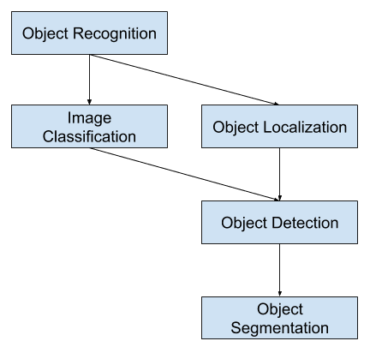
Objectives of the Work
Primary Goals:
Enhance knowledge of object detection.
Seeking different ideas on how object detection can be implemented on different sectord
Addressing challenges specific to certain application domains.
Importance:
Achieving these objectives is crucial for the practical success of object detection systems.
Improved accuracy ensures reliable results in diverse scenarios.

Slide 8
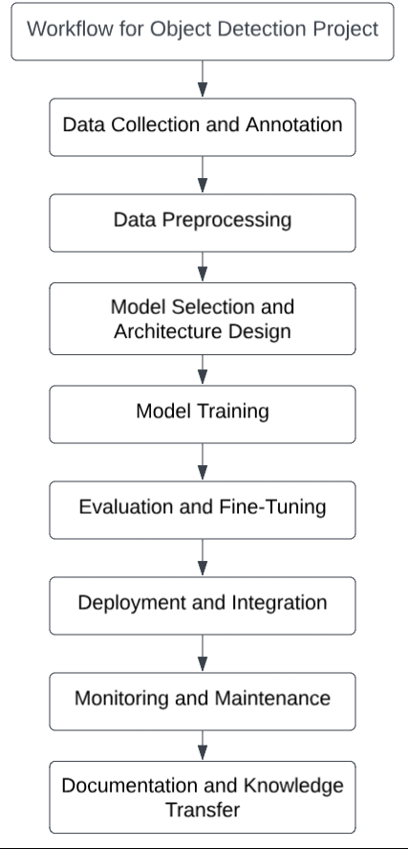
Planning to implement and Methodology used:
Implementation plan:
Data Collection and Annotation
Data Preprocessing
Model Selection and Architecture Design
Model Training
Evaluation and Fine-Tuning
Deployment and Integration
Monitoring and Maintenance
Documentation and Knowledge Transfer

Slide 9
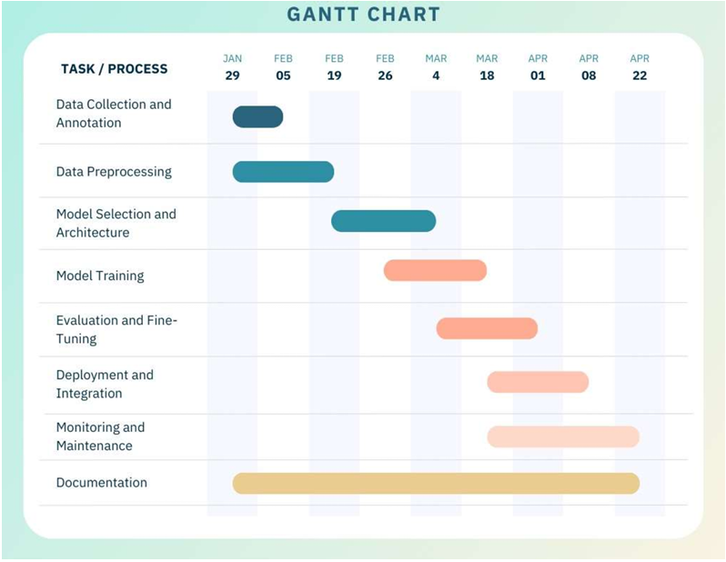
Planning to implement
Timeline

Slide 10
Task Details:
1. Data Collection and Annotation: Create or collect a comprehensive dataset reflecting real-world scenarios, including diverse lighting, backgrounds, and object orientations. Accurate annotation with bounding boxes defining object locations is crucial. Cover all relevant object classes for versatile feature learning in detection
2. Data Pre-processing: Prior to training, preprocess the dataset by resizing images to a uniform size, normalizing pixel values, and applying augmentations like rotation and flipping. These steps enhance training stability and aid in generalization.

Slide 11
3. Model Selection and Architecture Design: Select a suitable deep learning framework optimized for object detection, considering factors like model complexity, inference speed, and accuracy. Popular options like Faster R-CNN, YOLO, or SSD offer varying trade-offs. Tailor the chosen architecture to your application's requirements, adjusting layers or parameters for optimal performance under specific conditions.
4. Model Training: Start training with annotated data, adjusting model parameters and hyperparameters for better performance. Monitor loss and accuracy during training for convergence. Utilize transfer learning and validate on separate data to address overfitting or underfitting.

Slide 12
5. Evaluation and Fine-Tuning: Assess the trained model on a distinct validation set using metrics like precision, recall, and F1 score. Identify shortcomings and refine the model iteratively for improved object detection in diverse conditions.
6. Deployment and Integration: Deploy the object detection model for real-time or batch inference, integrating it into the system while ensuring compatibility and efficiency. Optimize for computational and latency requirements and validate performance in the deployment environment.

Slide 13
7. Monitoring and Maintenance: Establish a reliable monitoring system to oversee the model's production performance, configuring alerts for accuracy declines or anomalies. Regularly retrain the model with fresh data and keep abreast of object detection algorithm advancements for updates.
8. Documentation and Knowledge Transfer: Develop thorough documentation outlining the model's architecture, training methods, and deployment guidelines. Offer extensive guidance to stakeholders, developers, or end-users to ensure the model's comprehension, maintenance, and scalability, fostering long-term viability.

Slide 14
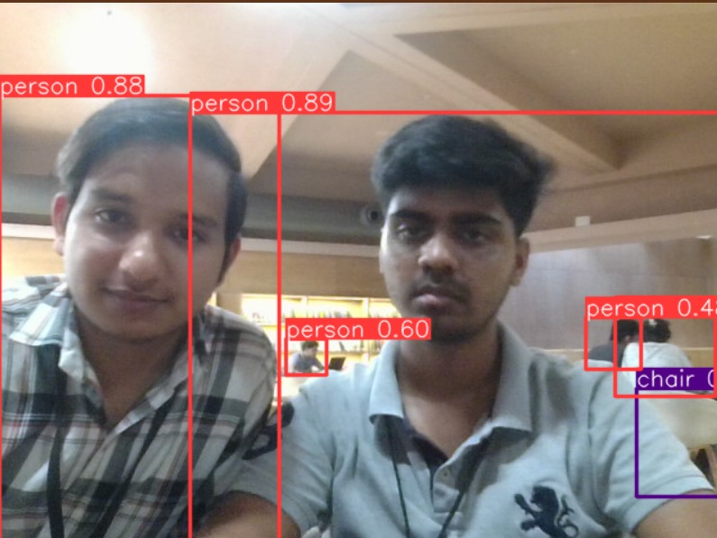
Results and Outputs
1. Development of a deep learning-based object detection model for applications in transportation safety and medical diagnostics.
Creation of a model capable of identifying objects in front of a camera.
Potential to address challenges in technologically advanced industries.
2. Advancement of understanding in object detection through deep learning.
Investigation and comprehension of object recognition.
Expansion of knowledge on object detection and its applications across sectors.
These two Objects are detected as person with an Accuracy of detection of object in this case as 0.8 out of 1.

Slide 15
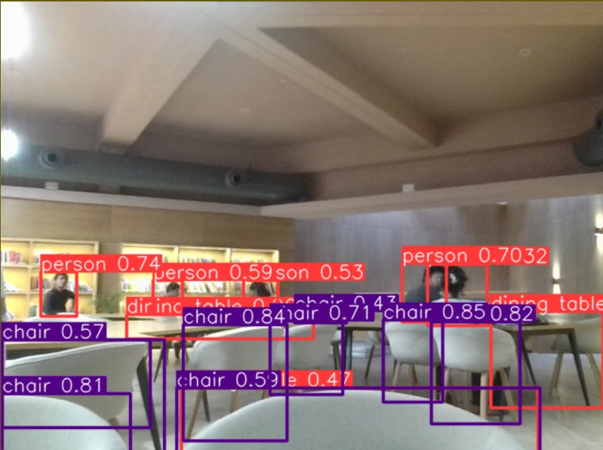
3. Exploration of contemporary machine learning models and traditional computer vision technologies.
Examination of strengths and weaknesses of various machine learning approaches.
Comparison of traditional methods with deep learning for object detection.
Recognition of the advantages of utilizing deep learning for object detection.
The Object present in this case are detected as chairs with an overall Accuracy of 0.85 out of 1.

Slide 16
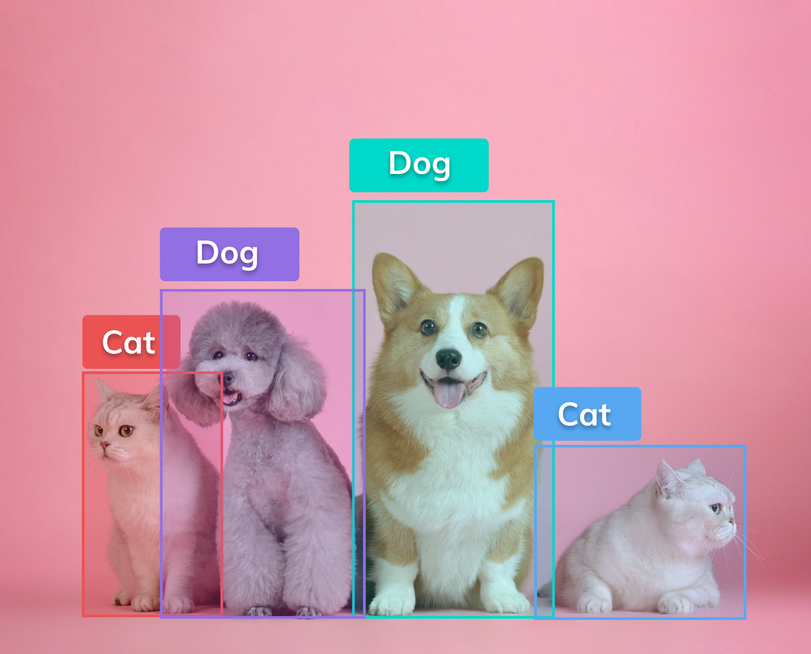
Conclusion
In Conclusion of this research, we have achieved the creation of a robust object detection model based on deep learning principles. Additionally, our comprehension of object detection, deep learning, and alternative machine learning models has been enriched. Furthermore, we have acquired the ability to discern and contrast traditional computer vision techniques with deep learning-based object detection methods.
This study has successfully developed a deep learning-powered object detection model for identifying and detecting objects, contributing to our comprehension of this field within our technologically advanced society. Through thorough investigation, we have gained deeper insights into object detection utilizing deep learning techniques, broadening our understanding of its applications across diverse sectors.

Slide 17
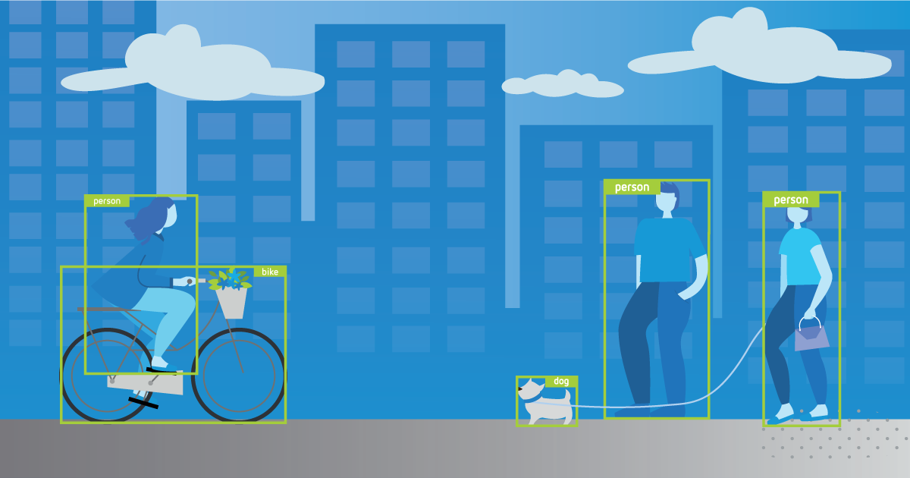
Future Scope
The future potential for Deep Learning-Based Object Detection appears promising, encouraged by ongoing technological advancements and expanding applications across various sectors.
Enhance accuracy and efficiency of object detection using deep learning in future research.
Model architecture advancements are key to better object detection.
Better accuracy comes from training models with more varied data.
Research can focus on specific solutions to expand object detection use.
Specific solutions can boost accuracy in healthcare, agriculture, manufacturing, and security.
Each domain's unique challenges will be met with specialized solutions.

Slide 18
References
D. Zhong-Qiu Zhao, Member, IEEE, Peng Zheng, Shou-tao Xu, and Xindong Wu,” Object Detection with DeepLearning: A Review” Fellow, IEEE, IN 16 APR 2019.
D. K. Vaishnavi a, G. Pranay Reddy a, T. Balaram Reddy a, N. Ch. Srimannarayana Iyengar a and Subhani Shaik a “Real-time Object Detection Using Deep Learning”.
D.Ajeet Ram Pathak'* , Manjusha Pandeya, Siddharth Rautaraya, “Application of Deep Learning for Object Detection” Procedia Computer Science 132(2018) 1706-1717
D. Jun Deng,a, Xiaojing Xuan,b, Weifeng Wang, Zhao Li, Hanwen Yao, ZhiqiangWang “A review of research on object detection based on deep learning”, Journal of Physics: Conference Series.
Andreas Geiger, Philip Lenz, Christoph Stiller and Raquel Urtasun, Vision meets Robotics: The KITTI Dataset, International Journal of Robotics Research (IJRR), 2013.
Diagnostic errors linked to nearly 800,000 deaths or cases of permanent disability in US each year, study estimates, By Deidre McPhillips, CNN.
P.Devaki, S.Shivavarsha, G.Bala Kowsalya, M.Manjupavithraa, E.A. Vima “ Real-Time Object Detection using Deep Learning and Open CV”, International Journal of Innovative Technology and Exploring Engineering (IJITEE) ISSN: 2278-3075, Volume-8 Issue-12S, October 2019.
Chinthakindi Kiran Kumar and Kirti Rawal 2022 J. Phys.: Conf. Ser. 2327 012012” A Brief Study on Object Detection and Tracking”.

Slide 19
THANK YOU

